Slide 1
FAST API
https://www.youtube.com/watch?v=7t2alSnE2-I
https://fastapi.tiangolo.com/tutorial/

Slide 2
https://www.youtube.com/watch?v=7t2alSnE2-I

Slide 3
Fast api provide swagger UI
ReDoc UI
Automatic Documentation
Pydantic library we can use.
Open API and JSON Schema

Slide 4
FAST API
FAST API
Security and Authentication
HTTP Basic
OAuth2 (also with JWT tokens )
API Keys in
-> Headers
-> Querys Paramenters.
-> Cookies, etc
FAST API

Slide 5
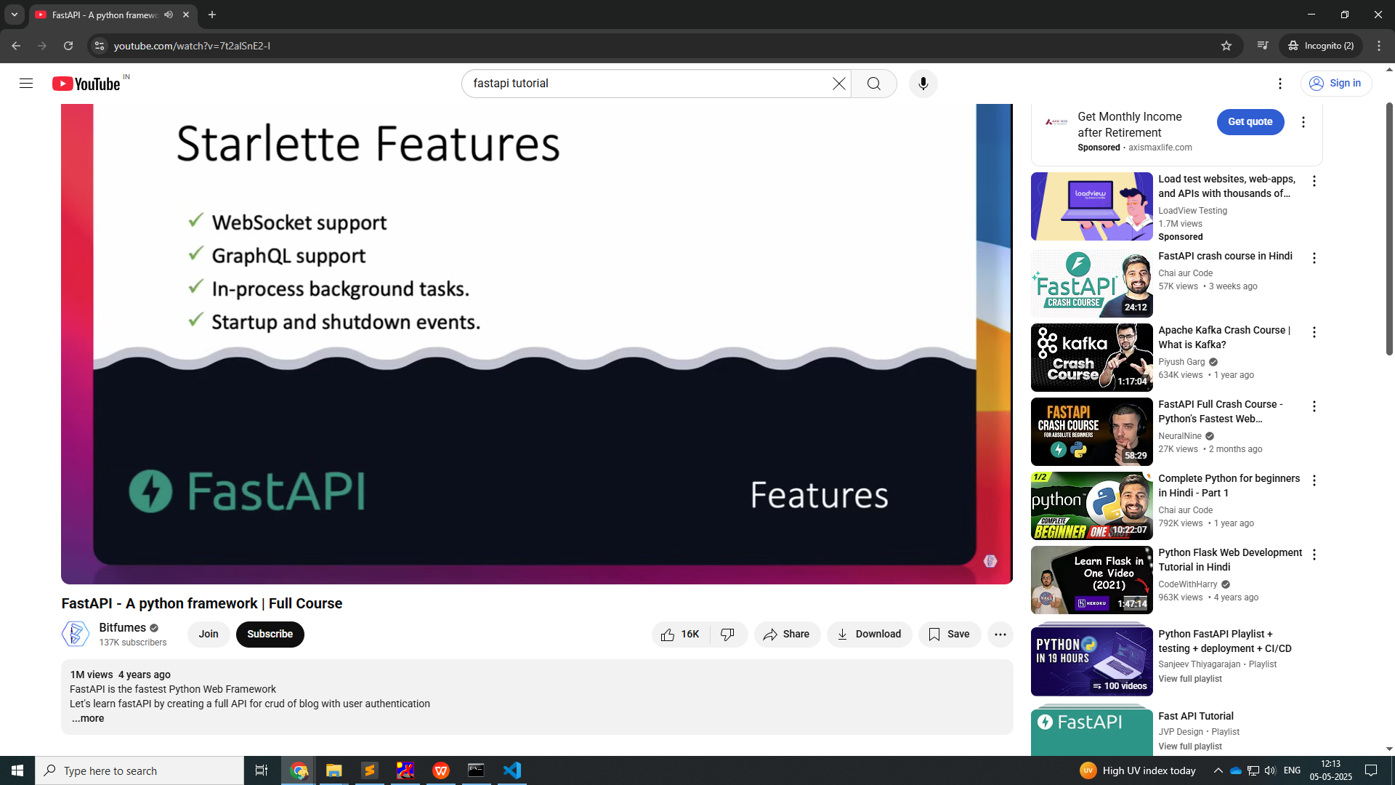

Slide 6
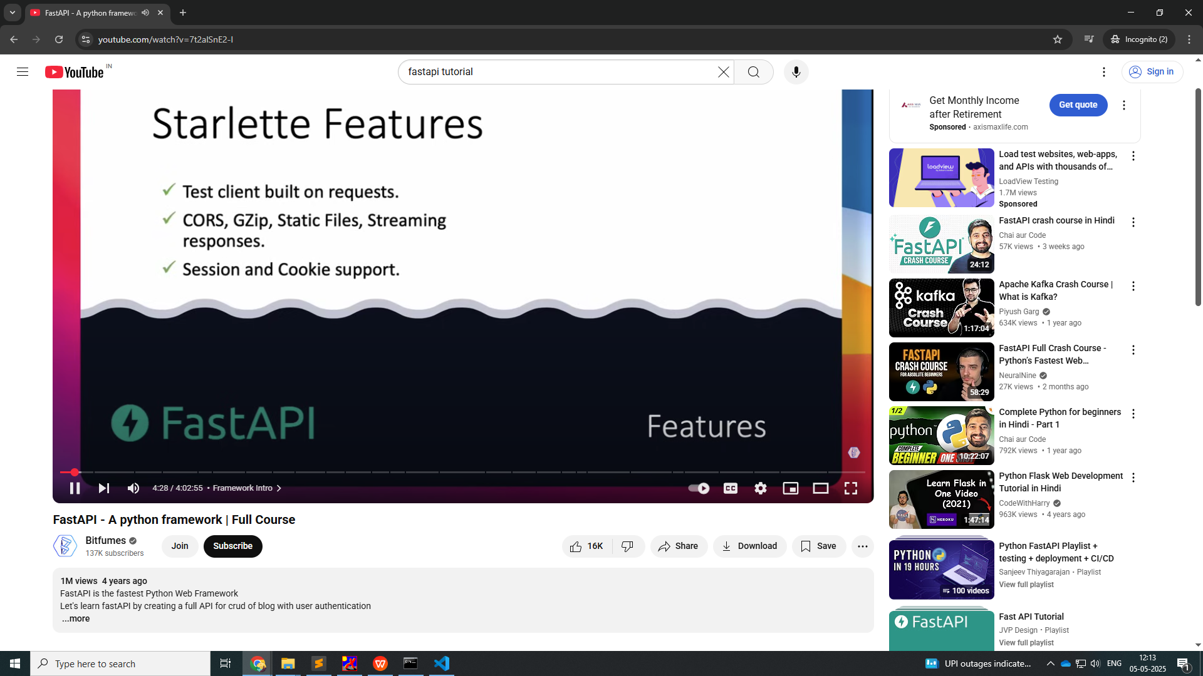

Slide 7
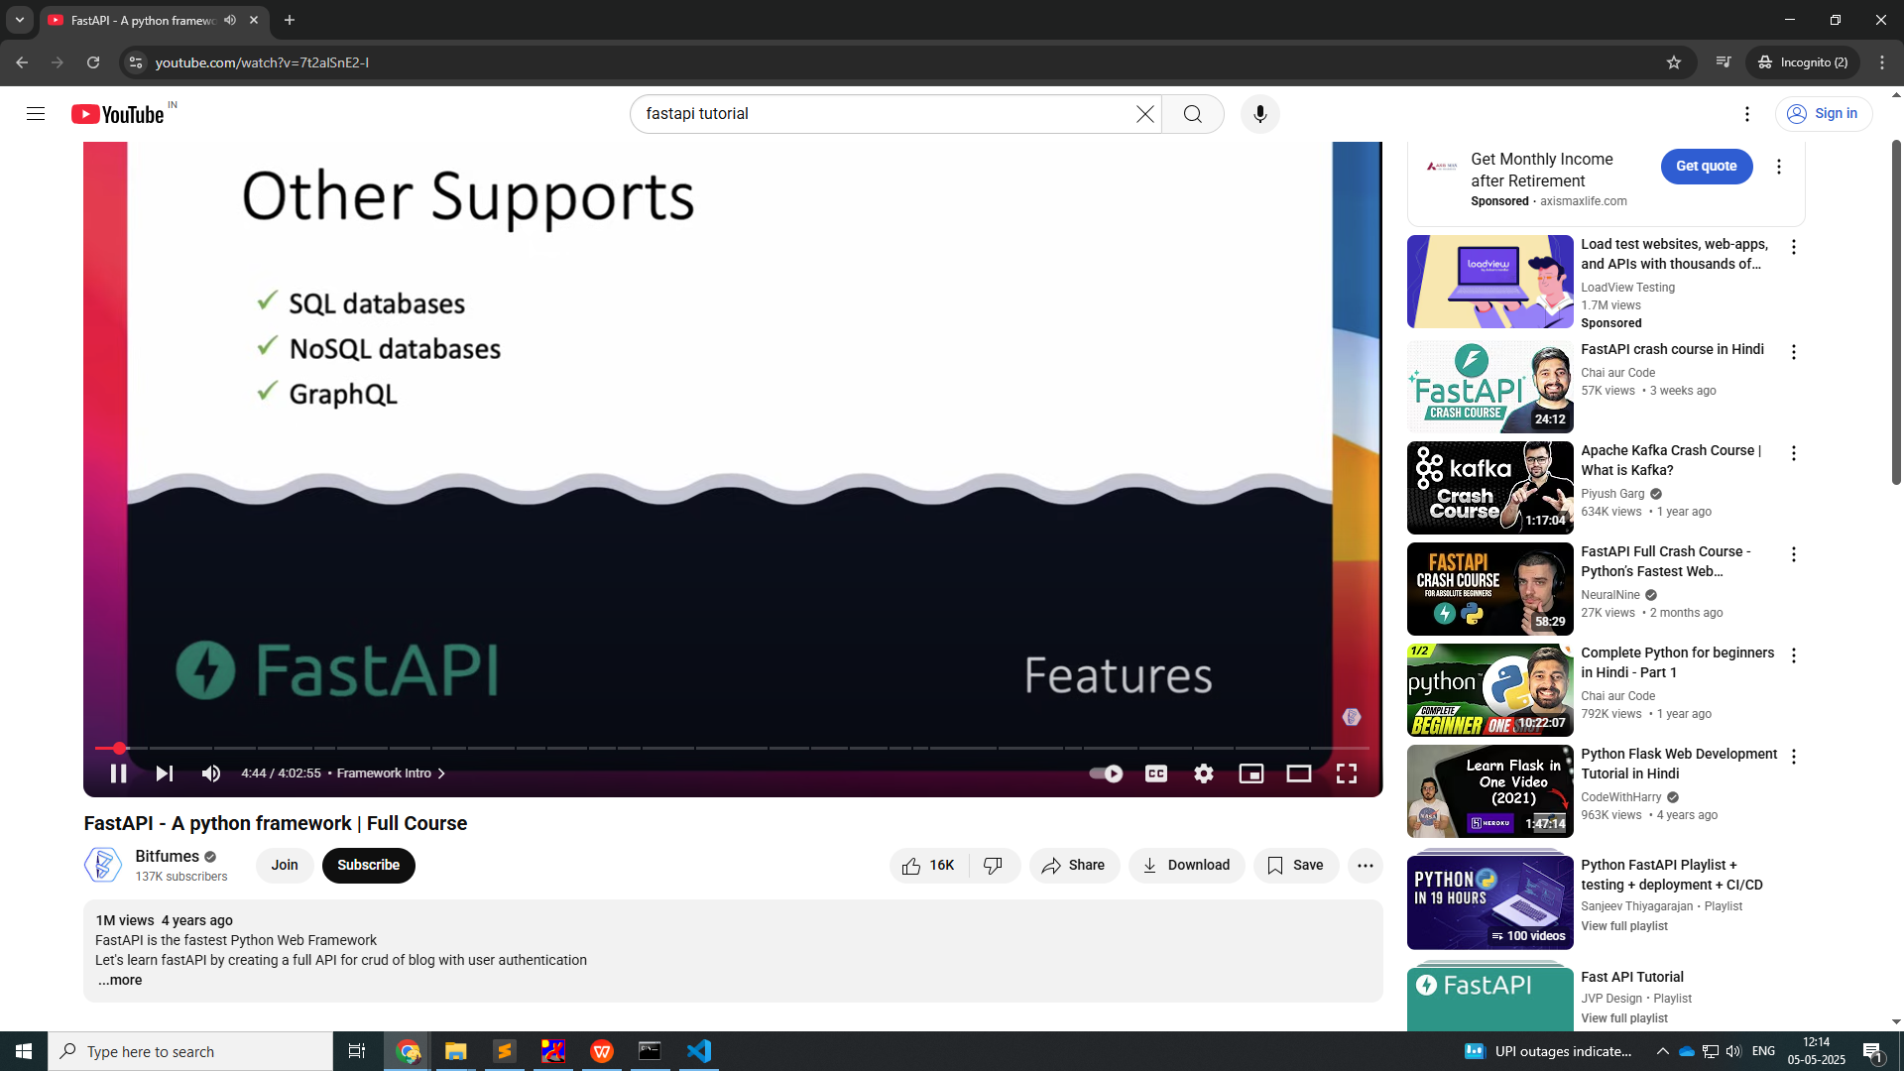

Slide 8
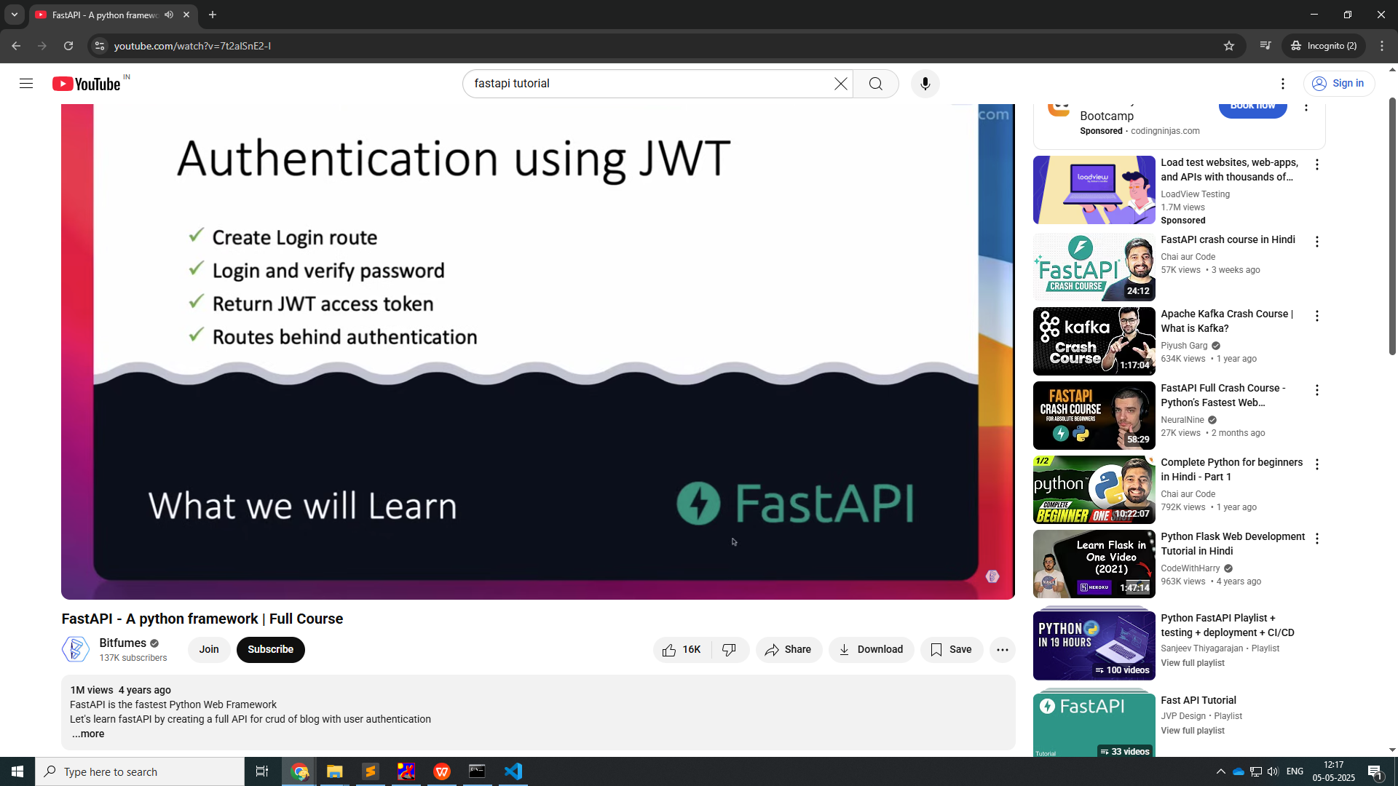

Slide 9
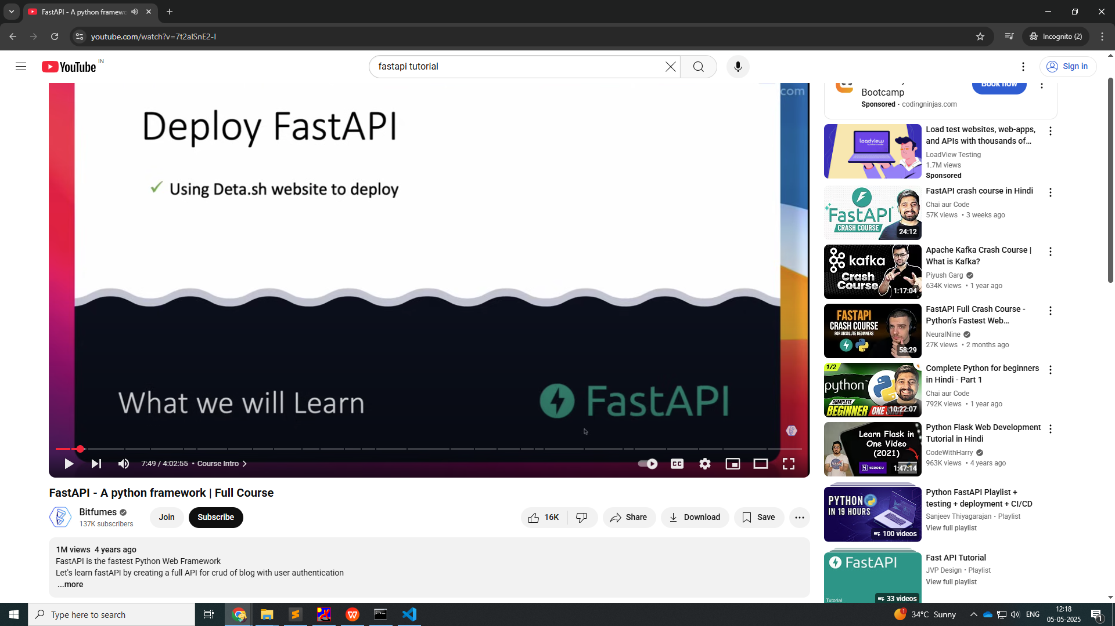

Slide 10
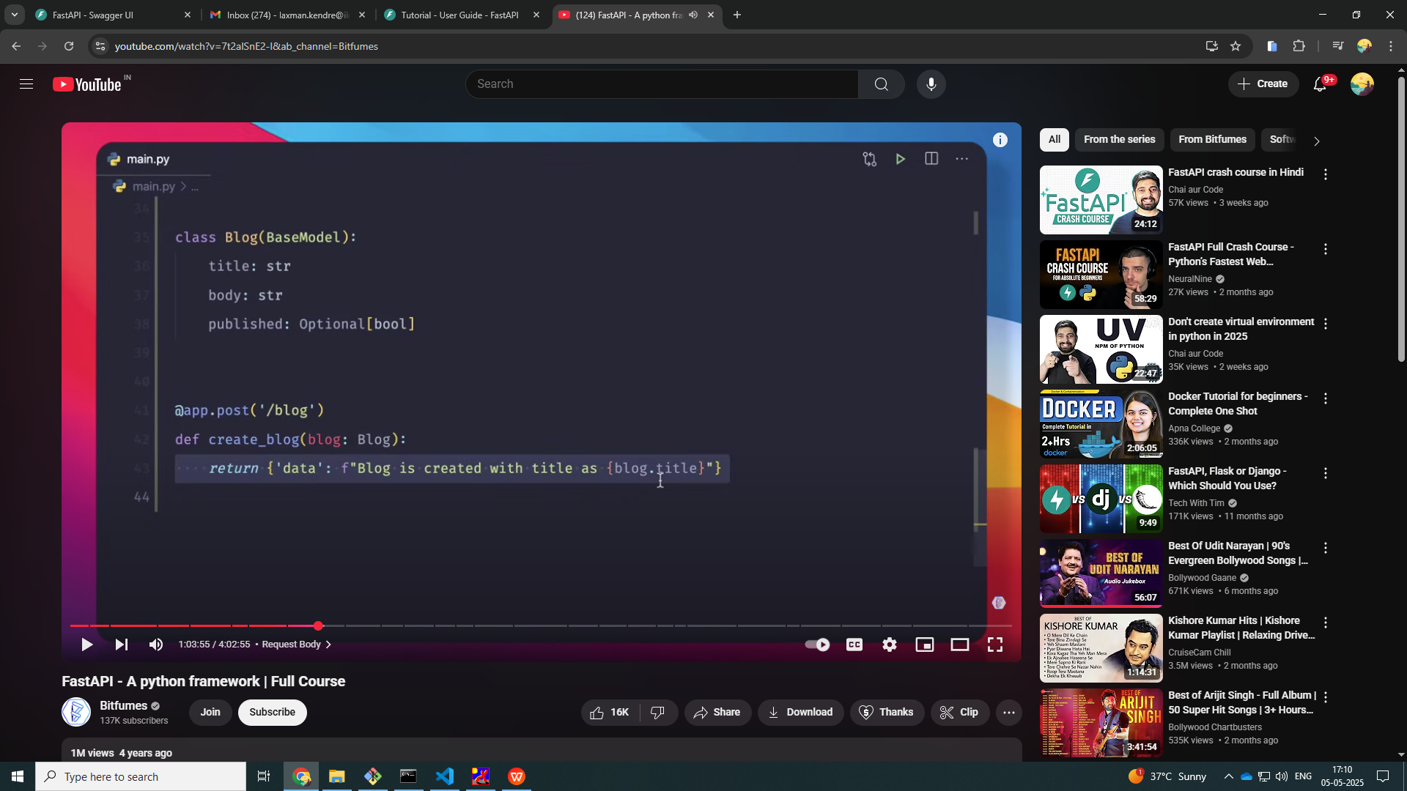

Slide 11
tableplus

Slide 12
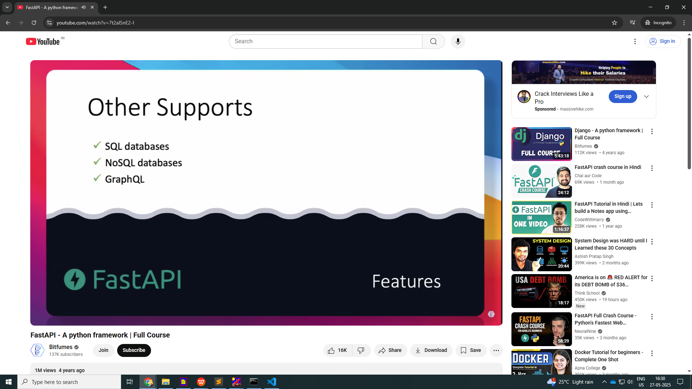

Slide 13
pip install fastapi
pip install uvicorn[standard]
create the main.py file
write the code
run: uvicorn main:app --reload

Slide 14
Query Phttp://127.0.0.1:8000/blog/published/?limits=1&publish=false' \arams
### QERY PARAMS ###
@app.get('/blog/published/')
def publish_blogs(limits, publish : bool):
if publish:
return {'data': 'this is the published blogs'}
else:
return {'data': 'this is the Unpublished blogs'}

Slide 15
from typing import Optional
from typing import Optional
@app.get('/optional/values/')
def optional1(limit:int, search: str, sort: Optional[int]= None):
if search == 'laxman':
return f'Laxman Kendre {limit} - {search} - {sort}'
else:
return f'Please search another string!!!'

Slide 16
POST Method
### POST METHOD ###
@app.post('/create-blog/')
def create_blog():
return {'resp': 'Blog has been created!!!'}

